Slide 1


Slide 2
Summary
The governor has until June 30 to sign the budget, and he has line-item veto authority.
The budget includes the proposal to transfer facilities on the USF Sarasota-Manatee campus to New College of Florida on July 1.
USF will retain more than $22 million in recurring operating funds, allowing us to support current students and retain the faculty and staff needed to complete the teach-out.
Every decision we make will be guided by three priorities: supporting students, supporting our employees and ensuring an orderly transition.
Notes:
Moez
OPENING (1-2 minutes)
Thank everyone for being here, both in person and online. This is an uncertain and emotional time and we are here today to share details as plans move forward.
I want to start today’s meeting by emphasizing two important points about what these changes mean for your day-to-day work over the coming weeks and months.
First: there will be very little change for the day-to-day of our employees come July 1. You will still park in the same parking lot, you will still have access to your buildings, and for most people, you will still sit at the same desk in your office.
The change you may start to notice soon after is that there will be more New College personnel on campus, along with some signage and branding changes.
Second: Once an employee is reassigned to a different campus, we fully expect there will be time to make that transition.
You will not be asked to switch overnight or start driving to Tampa for work the next week.
Every decision we make will be guided by three priorities:
Supporting students
Supporting employees
Ensuring an orderly transition
We will not have every answer today, but we will be transparent about what we know and what remains under development.
First: there will be very little change for the day-to-day of our employees come July 1. You will still park in the same parking lot, you will still have access to your buildings, and for most people, you will still sit at the same desk in your office.
The change you may start to notice soon after is that there will be more New College personnel on campus, along with some signage and branding changes.
Second: Once an employee is reassigned to a different campus, we fully expect there will be time to make that transition.
You will not be asked to switch overnight or start driving to Tampa for work the next week.

Slide 3
Three groups will help shape recommendations and identify issues that require attention.
Notes:
Moez – next slide provides some operations notes for each icon

Slide 4
Sarasota-Manatee Teach-Out Task Force
  Role: academic continuity, student success, accreditation requirements and operational planning necessary to ensure students can complete their degrees and continue receiving the support services they need throughout the teach-out.
  Co-chairs: Cindy DeLuca and Kaushik Dutta
Notes:
Moez
Teach-Out Task Force
Focused on academic continuity, student success and accreditation requirements.

Slide 5
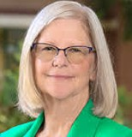

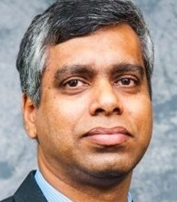
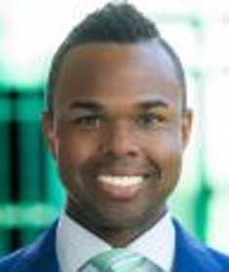
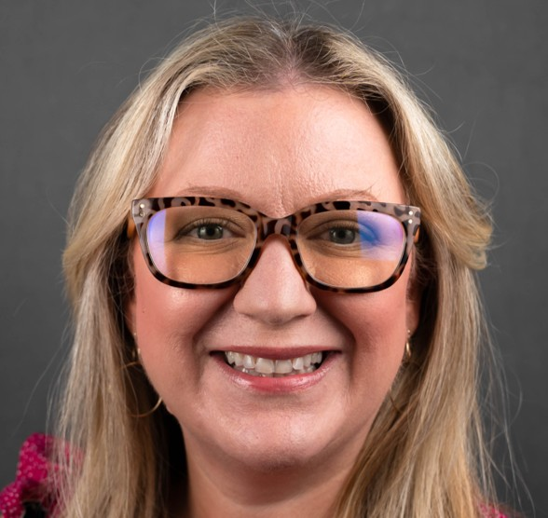
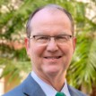
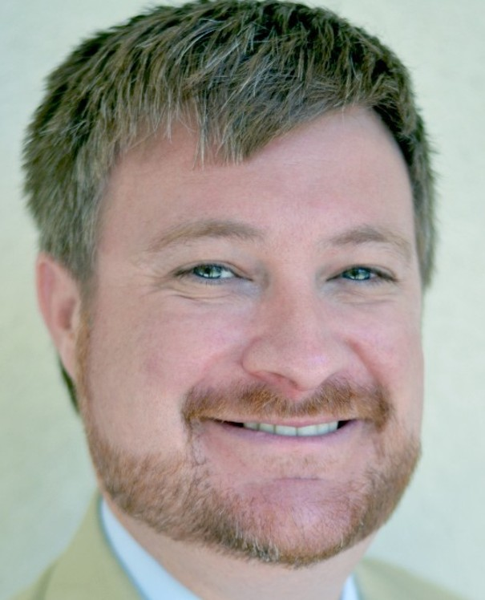
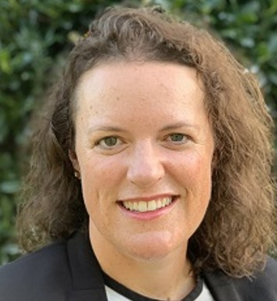
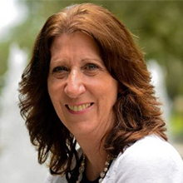
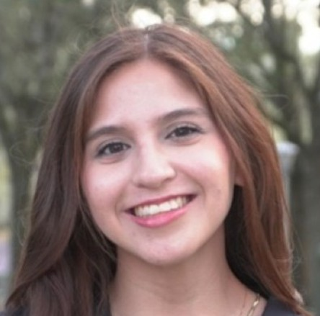
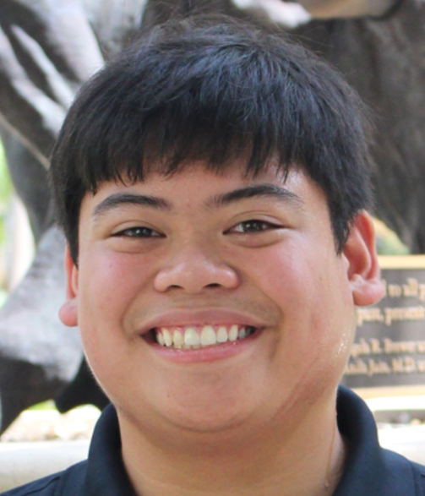
Cindy DeLuca
Vice President for Student Success
Julie Serovich (or designee)
USF College of Behavioral & Community Sciences
Kaushik Dutta
Vice Provost, USF Office of the Provost
David Blackwell (or designee)
USF Muma College of Business
Christopher Combie
USF Office of Institutional Effectiveness
Jenifer Jasinski Schneider (or designee)
USF College of Education
Jess Grosholz
USFSM Faculty Council
Usha Menon (or designee)
USF College of Nursing
Sarasota-Manatee Teach-Out Task Force
Brett Kemker
USFSM Interim Regional Chancellor and Vice Provost
Todd Chavez (or designee)
USF Libraries
Casey Welch
USFSM External Affairs and Government Relations
Jennifer Condon
Vice President and CFO
Allison Crume (or designee)
USF Undergraduate Studies
Brian Verkamp
Senior Vice President & Chief Administrative Officer
Ruth Bahr (or designee)
USF Graduate Studies
Tanya Vomacka
Chief of Staff and Associate Vice Provost
Elizabeth Spiller (or designee)
USF College of Arts and Sciences
Delaney Gutierrez
USFSM Student
Andre Aquino
USFSM Student
Notes:
Moez

Slide 6
USFSM Transition Advisory Working Group
  Role: advise university leadership on faculty and staff transition planning, shared governance, communication, operational matters and cross-campus equity.
  Co-chairs: Jess Grosholz and Jean Kabongo
Notes:
Moez
Transition Advisory Working Group
Focused on faculty and staff transitions, communication, shared governance and cross-campus equity.

Slide 7
Jess Grosholz
USFSM Faculty Council
Andrea Ortiz
Embedded Services
Jean Kabongo
USF Muma College of Business
Thomas Smith
USF St. Petersburg
Craig Dawson
General Counsel
Steve Tauber
USF Provost’s Office
USFSM Transition Advisory Working Group
Cindy DeLuca
Student Success
Casey Welch
USFSM External Affairs and Government Relations
Roberto Jimenez-Arroyo
Senate Intercampus Council
Cassandra Yacovazzi
USF College of Arts & Sciences
Carlos Moreira
USFSM Veteran Success and Alumni Affairs
Notes:
Moez

Slide 8
Operations Task Force
  Role: work on issues related to technology, facilities and other operational areas as assets are transitioned to New College of Florida.
  Chair: Jennifer Fleischman
Notes:
Moez
Operations Task Force
Focused on facilities, technology and operational continuity.
This work affects every part of the university, which is why broad representation is important.
I will now ask Gerard to provide an overview of the agreement between USF and New College, as well as the anticipated timeline for the first year of the teach-out.

Slide 9
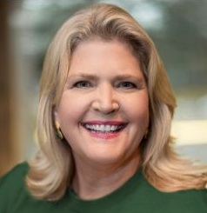
Jennifer Fleischman
Assistant Vice President of Administrative Operations
Sidney Fernandes
CIO and Vice President for Digital Experience
Everet Simmons
AVP, Campus Planning, Construction, and Development
Ana Hernandez
Associate Vice President Auxiliary Services and Strategic Contract Management
Operations Task Force
Joel Londrigan
Chief Regulatory Counsel
Teeranai Ovathanasin
USFSM Assistant Vice President, Student Success
Tanya Vomacka
Chief of Staff and Associate Vice Provost, Provost’s Office
Chris Daniel
AVP Public Safety and Chief of Police, USF Police Department
Notes:
Moez

Slide 10
JOINT TRANSFER AGREEMENT (JTA)
Notes:
Gerard – Hidden slide, only if needed

Slide 11
Material Terms
JTA will track sec. 1004.342, Florida Statutes
All transfers are contingent on NCF paying debt service on residence hall by 07/01/26 and assuming debt on the residence by 12/31/26. Failure nullifies transfers
Disputed transfers submitted to Board of Governors (BOG) for resolution based on statutory guiding principles
No USF student, employee, funds, or programs transfer
Notes:
Gerard – Hidden slide, only if needed

Slide 12
Transferring on 07/01/2026
Property Interests
  All USFSM real property interests
Legal interests
  Related contracts, leases, obligations, and liabilities
Costs
  All operating, maintenance, repair, and renovation costs
Buildings
  Academic, administrative, and residential (housing honored through 08/15/27)
Fixtures
  Permanent, immovable campus assets
Classrooms
  Standard furnishings and educational fixtures

Slide 13
Excluded from transfer
Students, employees, programs, funds
IP and intangible property
Educational and research equipment not permanently affixed
Computers and other equipment assigned to USF personnel
Records
Institutional insignia
Florida Center for Partnership in the Arts
Notes:
Gerard – Hidden slide, only if needed

Slide 14
Optional USF Continuing Services
Facilities
Dining
IT
Housing
Building access and security (not police)
Bookstore
Notes:
Gerard – Hidden slide, only if needed

Slide 15
Teach-Out (Provost)
We anticipate having a high-level draft of the teach-out plan by June 24 but these will continue to evolve.
Our focus is helping students continue making efficient progress toward degree completion. By law, the teach-out may extend for up to four years.
Student outreach is underway to confirm that each student knows their options and pathway forward.
Student populations will decrease over time; staffing, space and services will adjust.
Notes:
Moez: I will now ask Provost Mohapatra to discuss the teach-out process and how we will support students throughout this transition.
Prasant presents this slide. His notes:
I’d like to take a moment to discuss the teach-out process as a whole. This is a highly individualized process, and we must do it right and in our students' best interests.
To set the stage, college advisors are connecting directly with current students to discuss their options and identify a path forward; in parallel with the student communication, colleges are reviewing program needs and faculty preferences.
Teach-out plans will be driven by student needs, which will help inform our space requirements and what is needed from a faculty and staff perspective.

Slide 16
Key Questions
We do not have every answer today, but we are committed to sharing information as decisions are made.
Staff and faculty assignments
Buyout options for faculty and staff
Stipends, eligibility criteria and available funding
The role of the Faculty Advisory Council, Staff Advisory Council, SG, etc.
The physical campus after July 1, major and minor facilities issues, emergency preparedness
Parking passes and space occupancy after July 1
Notes:
Moez – tossing to others, questions come up one at a time.
I know many of you are listening for answers that affect you personally.
While we cannot answer every question today, we can commit that decisions will be made thoughtfully, shared transparently and communicated as soon as they are made.
Before opening the floor, we want to address several questions we know many of you have.

Slide 17


Q & A Session
Notes:
Moez – next slide provides some operations notes for each icon

Slide 18
Please mute your microphone unless you are speaking.
In the room: Raise your hand and a microphone will be brought to you.
Online: Use the “Raise Hand” feature or the chat.
When asking a question, please share your name and unit.
To help make space for everyone, please keep questions focused on one topic.
Note: FAQs will be updated regularly on the website.
Notes:
Moez
Q&A INSTRUCTIONS
We want to hear from as many people as possible.
Please keep questions to a single topic.
Share your name and unit before asking your question.
We will alternate between in-person and online questions.
We will add the most commonly asked questions to our FAQ page and provide ongoing updates as information becomes available.

Slide 19
Q & A Session
While we do not have every answer today, we do have a clear commitment: we will make decisions thoughtfully, communicate frequently and put students, faculty and staff at the center of this process.
Notes:
Moez
CLOSING
I know uncertainty is difficult.
Many of these decisions affect your daily lives and your families, and we take that responsibility seriously.
While we do not have every answer today, we do have a clear commitment.
We will make decisions thoughtfully.
We will communicate frequently.
We will put students, faculty and staff at the center of this process.
Thank you for your patience, professionalism and continued commitment to our students.

